Slide 1
Food, hunger and NCDs - food regimes and neoliberal crisis
David Legge
2017
Notes:
Ecological destabilisation
Widening inequalities
Public squalor; private affluence
Vast avoidable burden of disease
Continuing (and recurrent) financial crises

Slide 2
Overview
Stunting, overweight, wasting and NCDs
Agriculture: a global perspective (including global warming)
Agro technology choices
Land use choices / water use choices
meat production (and antibiotic abuse and biorisk)
biofuels
land grabbing
Consumption choices
foodstuffs and technologies
value chains and markets
Global food systems within the global economy: food regimes
Global economic governance and food systems
The crisis of over-production: the failed solutions of neoliberalism

Slide 3
Stunting, overweight, wasting and NCDs

Slide 14
Levels And Trends In Child Malnutrition UNICEF / WHO / WB Joint Child Malnutrition Estimates. Key findings of the 2017 edition

Slide 16
Fernald, L. C. and L. M. Neufeld (2006). "Overweight with concurrent stunting in very young children from rural Mexico: prevalence and associated factors
Rachmi, C. N., et al. (2016). "Stunting coexisting with overweight in 2·0–4·9-year-old Indonesian children: prevalence, trends and associated risk factors from repeated cross-sectional surveys." Public Health Nutrition 19(15): 2698-2707.

Slide 17
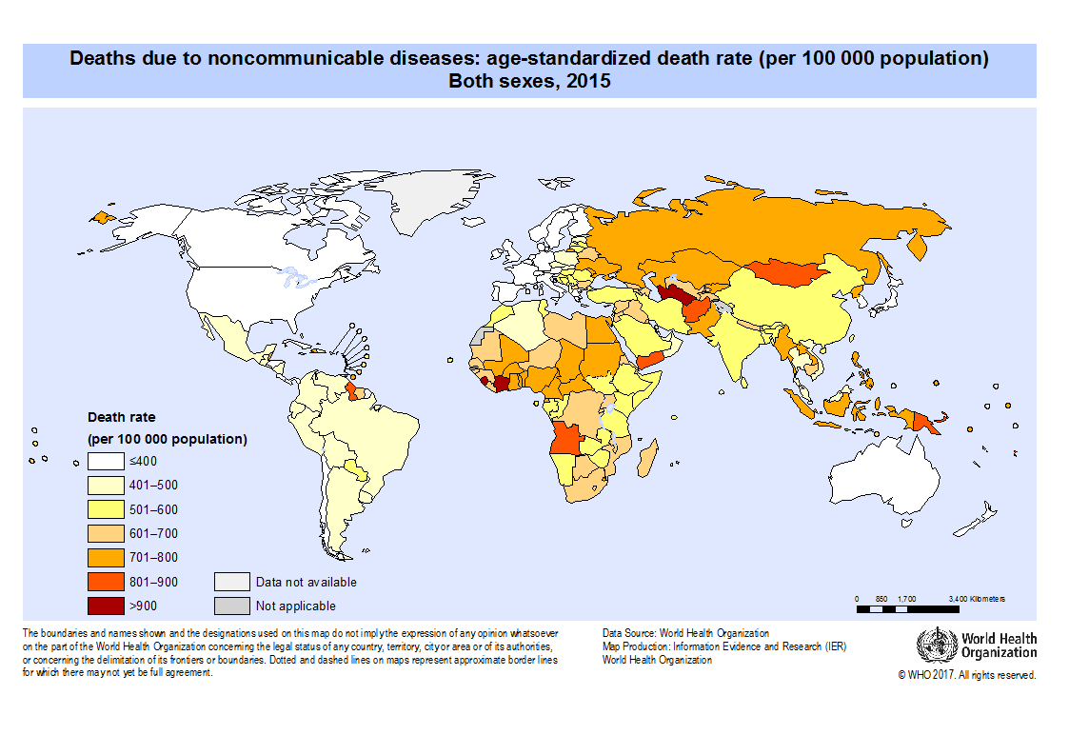

Slide 18
Probability of dying from NCD 30-70
WHO GHO NCDs portal

Slide 19
Agriculture Globally
7 billion hectare emerged land (including forest and savannah lands)
3.7 b ha land area with potential for rain-fed cultivation
1.5 b ha under crops (maximum of 1.7 billion ha of available)
450m small farmers,
2 b employed
50% world food production
The High Level Panel of Experts on Food Security and Nutrition. "Land Tenure and International Investments in Agriculture ". Rome: Committee on Food Security, FAO, 2011.

Slide 20
Porter, J. R., et al. (2014). Food security and food production systems. Climate Change 2014: Impacts, Adaptation, and Vulnerability. Part A: Global and Sectoral Aspects. Contribution of Working Group II to the Fifth Assessment Report of the Intergovernmental Panel of Climate Change. Cambridge University Press: 485-533.

Slide 21
Agro technology choices
Notes:
Under these circumstances, the strategic question of sovereignty refocuses from asserting the right of states to food policy autonomy to asserting the right of small-scale producers to productive autonomy.
Such refocusing is by no means the whole story of food sovereignty politics, which include questions about public health, rights of consumers to local foods, food justice concerns, worker protections, urban–rural alliance building, territorial rights among land users, food sovereignty constitutionalism, opposition to genetically-modified organisms (GMOs), environmental concerns, and so on (see, e.g., Andre´e, Ayres, Bosia, & Massicotte, 2014; Mann, 2014).
Beyond food’s materiality and nutritional qualities, food also has social, cultural, and ecological dimensions that contribute to the breadth and depth of ‘food sovereignty’ visioning.

Slide 23
Green revolution (from 1940s)
Productivity increases
more inputs
fertilisers
herbicides & pesticides
energy (machines)
water
patented seed varieties
hybrids
GMOs
Impact on food security / sovereignty
loss of market share
dependence on imports
power and profit for TNCs (Bayer, Monsanto, etc)
Impacts on small farmers
unemployment from import competition (mechanised broad acre farming supported by cheap energy)
peonage (dependence on seeds, herbicides & pesticides, fertilisers, and credit)
toxicity
urban migration
Impact on environment
use of water
soil degradation
run-off
energy

Slide 24
Large scale industrial farming
Input intense: seeds, herbicides, pesticides, fertiliser, water, energy and credit
Biased towards meat (stockfeed), biofuels and junk (sugary beverages and packaged foods)
Industrial meat production
Integrated in global value chains managed by TNCs (including seeds, chemicals, manufacturing, and big finance)
Supported through import protection and tariff barriers
Regulated by WTO, PTAs & BITs
Notes:
The food sovereignty movement rose to prominence via a powerful critique by Vı´a Campesina of the neoliberal discourse and practice of ‘food security’, describing a privatized food trading system institutionalized in WTO trade rules and managed by transnational food corporations.
The impact of this system was to deepen Southern food dependency on the international grain trade by undermining country-owned food and agricultural policies (already significantly weakened by structural adjustment). Sovereignty was compromised, and those who stood to lose (or had lost) their land and their ability to produce food for themselves and local markets coined the slogan ‘food sovereignty’ (Desmarais, 2007; Edelman, 2013; Nicholson & Delforge, 2008).
Food sovereignty emerged as a grassroots-based counter-movement to a neoliberal food regime claiming to feed the world through a global system of trade provisioned from ‘global granaries’ such as the USA and the EU. The counter-movement was, in the first instance, protective and restorative.
Finally, structural adjustment-imposed indebtedness of African (and Southern) states registers in rising sovereign debt, allowing capital to exert structural power on states to promote its strategic interests—in this case converting regions into supply zones for food and fuel products. As one vector of this structural power, value-chain agriculture, deploying credit relations to incorporate smallholders into commercial farming for corporate markets, expresses the conjunction of philanthro-capitalism and the financial crisis of neoliberalism.

Slide 25
Small farming under pressure in developing countries
Food self-sufficiency weakened by
structural adjustment (move to cash crops)
rich world protectionism
price volatility from speculation
Social impact
farmer suicides
urban migration with huge slums in big cities
periodic food crises
food aid (surplus/subsidised) further jeopardises local farmers
Notes:
The ‘yield gap’ is usually defined to mean the difference between realized productivity and the best that can be achieved using current resources and management practices (Foresight 2011a). Yield gaps can be quite significant - current yields in Africa for maize, oil palm, soybean and sugar cane are estimated at 20%, 32%, 32% and 54% respectively of what they could be (Foresight 2011b). Progress in bridging this ‗yield gap‘ will be important in meeting future world food needs and reducing the need to turn yet more land over to agriculture.
According to IFAD (2010), approximately 450 million small-scale farmers worldwide provide livelihoods for around 2 billion people. Smallholders are politically weak and their voices are rarely heard. Most of the discussion about ―modernising‖ agriculture and encouraging international investment take place in UN, G20 and World Bank circles, but not in the countries most concerned, nor with the people most affected. Donor and government circles hold a widespread belief that large-scale plantations are needed to ―modernise‖ agriculture, yet there is little evidence to back this up. While a few crops, such as sugar cane and cereals, offer significant economies of scale from mechanised production, many other crops can be grown equally well on small-scale holdings. And some are best grown on small-scale farms. For instance smallholders grow approximately 70 percent of the world‘s cocoa. (Clay 2004).
Pressures on small farming and third world urbanisation / also gender issues
Vertical integration, contract farming, power relations

Slide 26
Food sovereignty or food security?
Food sovereignty
national food policy autonomy
small scale productive sovereignty
Food security
continued dependence on imported foods from the protected North
small farms integrated within global value chains
input dependent
controlled by the procurement choices of processors and retailers
generating foreign currency
Notes:
Under these circumstances, the strategic question of sovereignty refocuses from asserting the right of states to food policy autonomy to asserting the right of small-scale producers to productive autonomy.
Such refocusing is by no means the whole story of food sovereignty politics, which include questions about public health, rights of consumers to local foods, food justice concerns, worker protections, urban–rural alliance building, territorial rights among land users, food sovereignty constitutionalism, opposition to genetically-modified organisms (GMOs), environmental concerns, and so on.
Beyond food’s materiality and nutritional qualities, food also has social, cultural, and ecological dimensions that contribute to the breadth and depth of ‘food sovereignty’ visioning.

Slide 27
Land use choices (and water)
meat
biofuels
land grabbing

Slide 28
Figure 1. Changes to food supply worldwide (A) in all major food groups and (B) with cereals excluded to allow closer visualization of the rise in meat supply.
Basu, Sanjay. "The Transitional Dynamics of Caloric Ecosystems: Changes in the Food Supply around the World." Critical Public Health 25, no. 3 (2015/05/27 2014): 248-64.
Notes:
Changes in the food supply worldwide over the past five decades are illustrated in
Figure 1. The greatest change in supply was the 204% rise in the supply of meat
products – an increase from 109 kcals/capita/day in 1961 to 222 kcals/capita/day in
2007.

Slide 29
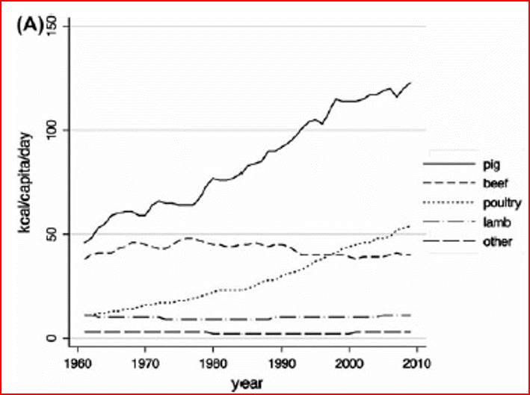
Figure 2. Rise in meat supply (worldwide)
Basu, Sanjay. "The Transitional Dynamics of Caloric Ecosystems: Changes in the Food Supply around the World." Critical Public Health 25, no. 3 (2015/05/27 2014): 248-64.
Notes:
The large increase in meat supply was mostly in the form of pig meat and poultry
meat, as shown in Figure 2. The increased meat supply in the form of pig meat
occurred primarily in Southeast Asia, as shown in the figure. While pig meat supplies
increased most substantially in China, the supplies simultaneously decreased in Western
European and Central American countries. By contrast, the increase in poultry meat
supply occurred in nearly all world regions, as shown in Figure 2. The increase in poultry
meat was greatest in North America, where poultry meat consumption increased
316% from 64 kcals/capita/day in 1961 to 202 kcals/capita/day in 2007. As shown in
the figure, increases in poultry meat supply also occurred to a lesser extent in Africa,
Latin America, and Eastern Europe.

Slide 30
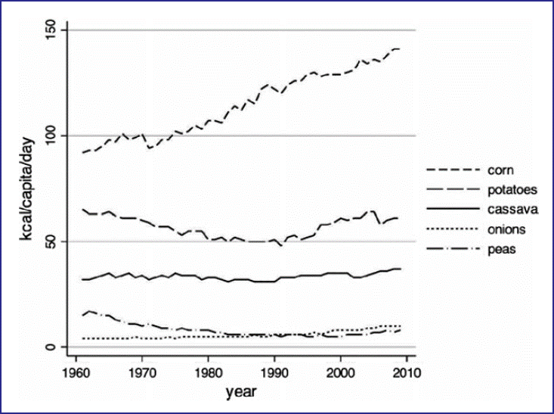
Figure 3. Vegetable supply changes worldwide.
Basu, Sanjay. "The Transitional Dynamics of Caloric Ecosystems: Changes in the Food Supply around the World." Critical Public Health 25, no. 3 (2015/05/27 2014): 248-64.
Notes:
While smaller than the increase in meat supply, the vegetable supply also increased worldwide, as shown in Figure 3. The increase in vegetable supply was mostly in the form of corn and maize products. The increase in corn and maize products was greatest in North and West Africa, where a net increase of approximately 100 kcals/capita/day occurred between 1961 and 2007 in the context of large international aid shipments (i.e. not domestic production). Apart from these increases, further increases in vegetable supply per capita were also observed in Southeast Asia to a lesser extent.

Slide 31
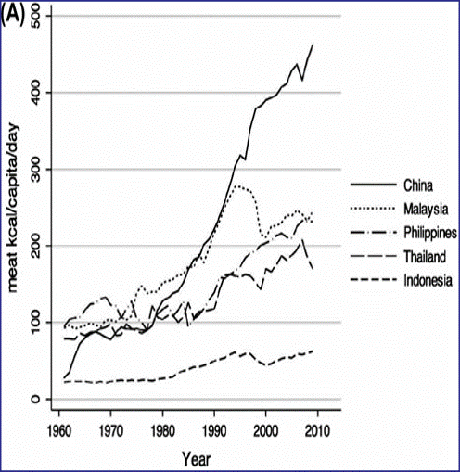
Intraregional supply changes: (A) meat supply in Southeast Asia;
Basu, Sanjay. "The Transitional Dynamics of Caloric Ecosystems: Changes in the Food Supply around the World." Critical Public Health 25, no. 3 (2015/05/27 2014): 248-64.

Slide 32
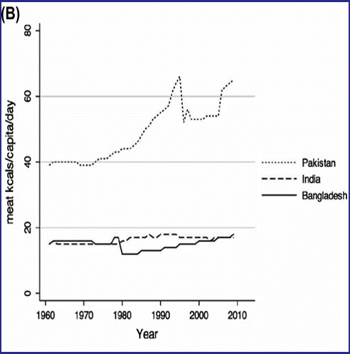
Intraregional supply changes:
(B) relative stability in meat supply in South Asia despite economic growth in India
Basu, Sanjay. "The Transitional Dynamics of Caloric Ecosystems: Changes in the Food Supply around the World." Critical Public Health 25, no. 3 (2015/05/27 2014): 248-64.

Slide 33
Use of land for meat
Pasture 35 m km²
Cropland 14 m km²
Human plant feed 9.4 m km²
Stockfeed 4.7 m km²
Total meat output
Grazing 8%
Mixed 46%
Intensive 45%
Steinfeld, Henning, Pierre Gerber, Tom Wassenaar, Vincent Castel, Mauricio Rosales, and Cees de Haan. "Livestock's Long Shadow: Environmental Issues and Options." Rome: FAO, 2006.
Notes:
Today, feed production is estimated to use approximately 30 percent of the emerged land.
Statistics on pasture add up to 34.8 million km2 globally (26 percent of emerged land) while we estimate that about 4.7 million km2 of cropland are currently dedicated to feed production (4 percent of emerged land or 33 percent of all cropland). The latter does not include crop residues but includes most agro-industrial byproducts (see methodological note in Annex 3).
In comparison, the shares of total meat output from grazing, mixed and intensive landless, are estimated at 8 percent, 46 percent and 45 percent respectively (see Section 2.4). The juxtaposition of these figures gives a sense of the strong intensity gradient along which livestock use land.

Slide 34
The cost of meat protein
Producing 1 kg of high-quality animal protein requires:
6 kg plant protein
100 times more water than 1 kg of grain protein
11 times more fossil energy than for grain protein production
Pimentel, David, and Marcia Pimentel. "Sustainability of Meat-Based and Plant-Based Diets and the Environment." The American Journal of Clinical Nutrition 78, no. 3 (September 1, 2003 2003): 660S-63S
Notes:
The average protein intake in the industrialised countries is around 106 g/day per person. Just over half of this comes from livestock.
The RDA is 56 g/day from a mixed diet.
The average protein intake in Sub-Saharan Africa is just over half of that in the industrialised countries and 80% of this comes directly from plant based foods.
The situation was not much better in Asia although there were significant improvements from 1980 to 2002.
These are averages. It is likely that in all regions the total protein and livestock component are higher for richer people and lower, sometimes much lower, for the poor. The fact that the average for SSA just equalled the RDA points to the widespread under nutrition in Africa.
For every 1 kg of high-quality animal protein produced, livestock are fed about 6 kg of plant protein. Producing 1 kg of animal protein requires about 100 times more water than producing 1 kg of grain protein. The average fossil energy input for all the animal protein production systems studied is 25 kcal fossil energy input per 1 kcal of protein produced (Table 2). This energy input is more than 11 times greater than that for grain protein production, which is about 2.2 kcal of fossil energy input per 1 kcal of plant protein produced. (Pimentel, David, and Marcia Pimentel. "Sustainability of Meat-Based and Plant-Based Diets and the Environment." The American Journal of Clinical Nutrition 78, no. 3 (September 1, 2003 2003): 660S-63S)

Slide 35
Fossil energy cost for 1 kcal protein (ratio input to output)
Product | Energy cost (ratio of input: output)
Lamb | 57
Beef | 40
Eggs | 39
Pork | 14
Milk | 14
Poultry | 4
Grain | 0.25
Pimentel, David, and Marcia Pimentel. "Sustainability of Meat-Based and Plant-Based Diets and the Environment." The American Journal of Clinical Nutrition 78, no. 3 (September 1, 2003 2003): 660S-63S
Notes:
USA data!

Slide 36
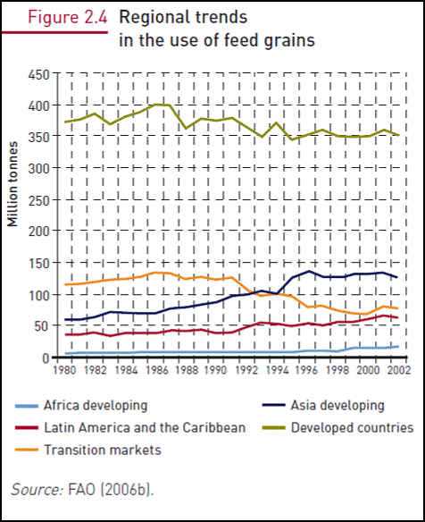
Steinfeld, Henning, Pierre Gerber, Tom Wassenaar, Vincent Castel, Mauricio Rosales, and Cees de Haan. "Livestock's Long Shadow: Environmental Issues and Options." Rome: FAO, 2006.

Slide 37
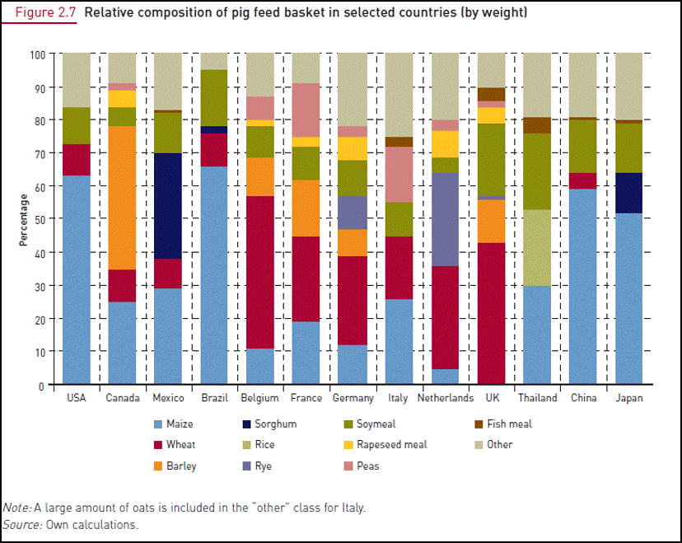
Steinfeld, Henning, Pierre Gerber, Tom Wassenaar, Vincent Castel, Mauricio Rosales, and Cees de Haan. "Livestock's Long Shadow: Environmental Issues and Options." Rome: FAO, 2006.

Slide 38
Antibiotics

Slide 39
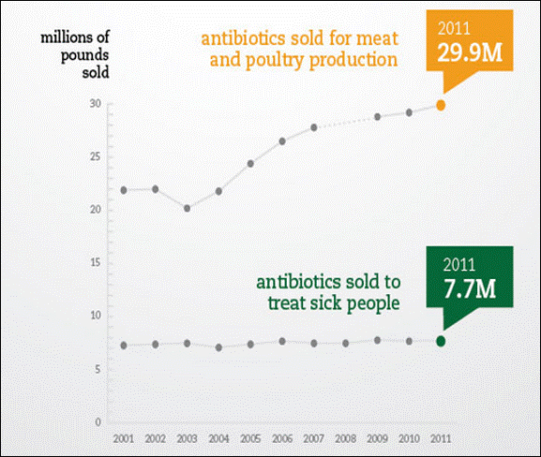
80% of antibiotics sold in USA are for use in factory farming
Pew Charitable Trusts (2013). http://www.pewtrusts.org/en/about/news-room/news/2013/02/06/recordhigh-antibiotic-sales-for-meat-and-poultry-production

Slide 40
55 foodborne outbreaks between 1973 and 2011 caused by bacteria resistant to at least one antibiotic
Centre for Science in the Public Interest (2013). Antibiotic resistance in food borne pathogens. http://cspinet.org/new/pdf/outbreaks_antibiotic_resistance_in_foodborne_pathogens_2013.pdf
Notes:
The 55 reported outbreaks sickened 20,601 individuals, of whom 3,166 required hospitalization and 27 died. Two‐thirds (67%) of the deaths were due to a huge milk‐ associated outbreak in 1985 that killed 18 and sickened 16,659 people. That outbreak was also responsible for 88% (2,777) of all reported hospitalizations.

Slide 41
Biosecurity
Industrial farming (poultry and pigs especially) and generation of new pandemics

Slide 42
Food Tank (2014)

Slide 43
Food Tank (2014) Rethinking industrial animal production

Slide 44
Branswell (2011) ‘Flu factories’ Sci Am Jan 2011, p 46

Slide 45
Morens, Taubenberger, Fauci (2009) NEJM 361,3,225

Slide 46
Biofuels

Slide 47
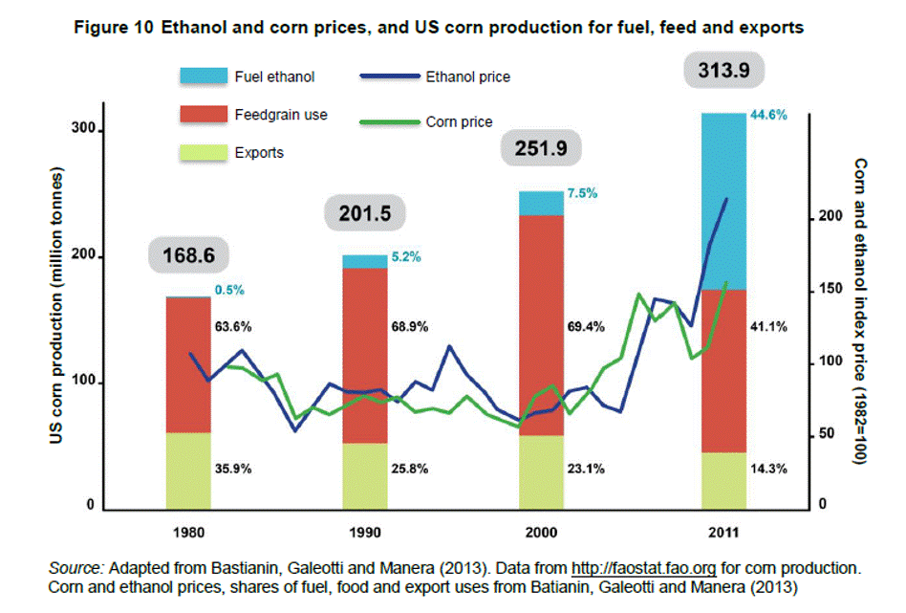
High Level Panel of Experts on Food Security and Nutrition. "Biofuels and Food Security." Rome: FAO, 2013.
Notes:
Today, feed production is estimated to use approximately 30 percent of the emerged land. Statistics on pasture add up to 34.8 million km2 globally (26 percent of emerged land) while we estimate that about 4.7 million km2 of cropland are currently dedicated to feed production
(33 percent of all cropland).
For example, in 2007 the United States diverted more than 30 per cent of its maize production, Brazil used half of its sugar cane production, and the European Union (EU) used the greater part of its vegetable oil seed production, as well as imported vegetable oils, to make biofuels (Polya 2008).
The share of US corn production directed to ethanol increased in one decade from less than 10 percent to over 40 percent in the 2010/11 crop year, and remained at that high level in 2011/2012. (High Level Panel of Experts on Food Security and Nutrition. "Biofuels and Food Security." Rome: FAO, 2013)
Land grabs, esp in Africa, driven by biofuels and food. Both in terms of area and number of transactions, jatropha emerges in first place (4.4 million ha and 99 deals) followed closely by palm oil and sugar cane. In contrast to the media, which it argues assigns priority to food interests: “the large proportion of jatropha, oil palm and sugar-cane points to the growth of investments in biofuels, which may be inflated due to media reports but are undoubtedly a major driver of transnational land acquisition” (op. cit. p.12). HLPE
Food insecurity is the result of land constraints for the majority of the rural poor. Policies facilitating their access to land, therefore, should be a priority from the point of view of food security and agricultural modernization. Most States, however, are committed to redefining communal lands for the benefit of large-scale private investments, including biofuels.
Plus Brazilian plans to replace the Amazon with sugar for fuel

Slide 48
Land grabbing
Notes:
Currently, one billion people in middle and low income countries are short of food and another billion suffer from various forms of malnutrition, despite sufficient global food production. Prices of all foodstuffs have continued to rise since late 2010, pushing even more people into poverty and hunger. Yet in recent years an estimated 50-80 millions of hectares of land has been acquired in middle and low income countries by international investors through lease or purchase.

Slide 49
Foreign investment in big farms(land grabbing)
The High Level Panel of Experts on Food Security and Nutrition. "Land Tenure and International Investments in Agriculture ". Rome: Committee on Food Security, FAO, 2011.
Notes:
Under-estimate
2/3 in Africa
Domestic land deals may be more significant
Debate over marginal lands
Customary use; 5 year fallow.
Displacement, urbanisation
This paper situates the land grab in a broader restructuring of the corporate food regime – from food-surplus to food-deficit relations. While the former relations impoverished peasant cultures via an ethos of cheap food for the world (‘food security’), the latter promises to accelerate dispossession in the name of managing endemic food insecurity (‘food crisis’) resulting from the cheap food regime’s neglect of domestic food security mechanisms and destabilization of populations, environments and the climate. The land grab is the medium through which the development agencies attempt to renew their legitimacy (constructing voluntary codes of conduct) in the face of a rising food sovereignty movement, and through which finance capital can profit even as capitalism enters a profound crisis of political legitimacy, and energy and environmental limits.
Stemming rising costs of inputs (especially energy and food) depends on a landed frontier of accumulation. In the new bio-economy, the basic ingredients are indiscriminate crop production via a process of enhanced enclosure of Southern land, accompanied by a normative appeal to securing world food and green fuel supplies at a time of crisis. The Bank’s ‘agriculture for development’ is an afterthought that presents as a new development strategy, even as it sanctions land grabbing for the security of ‘capital’ in the name of a reformulated global ecology. ‘Rational planning of the planet’ for security purposes remains the basic rationale, although as argued earlier, there is no such security to be had, and the land grab – to the extent that it is incapable of recognizing the salience of low-carbon bio-diverse agriculture – is the ultimate death wish as industrial biofuels and value-added agriculture will not resolve the combined problems of climate change and food insecurity. They will only buy time (and space!) in the short run for political and economic elites and consumers with purchasing power. In this scenario the longer run is destined to be catastrophic.
ABSTRACT International studies routinely consign agri-food relations to the analytical margins, despite the substantive historical impact of the agri-food frontiers and provisioning on the structuring of the interstate system. As a case in point, current restructuring of the food regime and its global political-economic coordinates is expressed through the process of ‘land grabbing’. Here, the crisis of the WTO-centered corporate food regime, which has neoliberalized Southern agriculture while sustaining Northern agro-food subsidies, is manifest in a new form of mercantilism of commandeering offshore land for supplies of food, feed, and fuel. This article examines the content and implications of this new ‘security mercantilism’, which both affirms and contradicts a neoliberal order, anticipating a shift in international relations around resource grabbing.

Slide 50
Land grabbing: the drivers
Domestic food security
Export (food, feedstock, biofuel stock)
Forestry
Carbon credits
Speculation
Notes:
This paper situates the land grab in a broader restructuring of the corporate food regime – from food-surplus to food-deficit relations. While the former relations impoverished peasant cultures via an ethos of cheap food for the world (‘food security’), the latter promises to accelerate dispossession in the name of managing endemic food insecurity (‘food crisis’) resulting from the cheap food regime’s neglect of domestic food security mechanisms and destabilization of populations, environments and the climate. The land grab is the medium through which the development agencies attempt to renew their legitimacy (constructing voluntary codes of conduct) in the face of a rising food sovereignty movement, and through which finance capital can profit even as capitalism enters a profound crisis of political legitimacy, and energy and environmental limits.
Stemming rising costs of inputs (especially energy and food) depends on a landed frontier of accumulation. In the new bio-economy, the basic ingredients are indiscriminate crop production via a process of enhanced enclosure of Southern land, accompanied by a normative appeal to securing world food and green fuel supplies at a time of crisis. The Bank’s ‘agriculture for development’ is an afterthought that presents as a new development strategy, even as it sanctions land grabbing for the security of ‘capital’ in the name of a reformulated global ecology. ‘Rational planning of the planet’ for security purposes remains the basic rationale, although as argued earlier, there is no such security to be had, and the land grab – to the extent that it is incapable of recognizing the salience of low-carbon bio-diverse agriculture – is the ultimate death wish as industrial biofuels and value-added agriculture will not resolve the combined problems of climate change and food insecurity. They will only buy time (and space!) in the short run for political and economic elites and consumers with purchasing power. In this scenario the longer run is destined to be catastrophic.
ABSTRACT International studies routinely consign agri-food relations to the analytical margins, despite the substantive historical impact of the agri-food frontiers and provisioning on the structuring of the interstate system. As a case in point, current restructuring of the food regime and its global political-economic coordinates is expressed through the process of ‘land grabbing’. Here, the crisis of the WTO-centered corporate food regime, which has neoliberalized Southern agriculture while sustaining Northern agro-food subsidies, is manifest in a new form of mercantilism of commandeering offshore land for supplies of food, feed, and fuel. This article examines the content and implications of this new ‘security mercantilism’, which both affirms and contradicts a neoliberal order, anticipating a shift in international relations around resource grabbing.

Slide 51
Cotula, Lorenzo, Sonja Vermeulen, Rebeca Leonard, and James Keeley. "Land grab or development Opportunity? Agricultural Investment and International Land Deals in Africa." Rome: FAO, 2009.

Slide 52
Cotula, Lorenzo, Sonja Vermeulen, Rebeca Leonard, and James Keeley. "Land grab or development Opportunity? Agricultural Investment and International Land Deals in Afric." Rome: FAO, 2009.

Slide 53
Health Poverty Action, Jubilee Debt Campaign, World Development Movement, African Forum and Network on Debt and Development (AFRODAD), Friends of the Earth Africa, Tax Justice Network, People’s Health Movement Kenya Zimbabwe and UK, et al. "Honest Accounts? The True Story of Africa's Billion Dollar Losses." 2014.
Notes:
a comprehensive comparison of the range of resource flows in and out of Africa. We calculate the money leaving Africa every year and compare this to the resources flowing in. Our researchshows that Africa loses:
• $46.3 billion in profits made by multinational companies
• $21 billion in debt payments, often following irresponsible loans
• $35.3 billion in illicit financial flows facilitated by the global network of tax havens
• $23.4 billion in foreign currency reserves given as loans to other governments
• $17 billion in illegal logging
• $1.3 billion in illegal fishing
• $6 billion as a result of the migration of skilled workers from Africa
In addition to these resource flows Africa is forced to pay a further:
• $10.6 billion to adapt to the effects of climate change that it did not cause
• $26 billion to promote low carbon economic growth
If these financial outflows and costs are compared with inflows into Africa, the result is a net annual loss of $58.2 billion. This is over one and half times the amount of additional money needed to deliver affordable health care to everyone in the world. If the rest of the world continues to raid Africa at the same rate, $580 billion will be taken from the African people over the next ten years.

Slide 54
Consumption choices
Foodstuffs and technologies
Value chains and markets

Slide 55
Foodstuffs and technologies
Sugar, high fructose corn syrup, salt, fat
taste
marketing
Cereals (eg maize, millet, rice, wheat)
local versus imported
Protein
meat, dairy, beans
cost and access
Water content, freight costs and shelf life
fresh fruit and vegetables versus highly processed food products
local production versus global sourcing

Slide 56
Foodstuffs, value chains and markets
Monopoly and global value chains
farm workers and farmers
commodity traders, food manufacturers
brand marketing
retail including supermarkets
consumers
Different markets
Europe
South Asia
East Asia
USA
Oceania
Australia

Slide 57
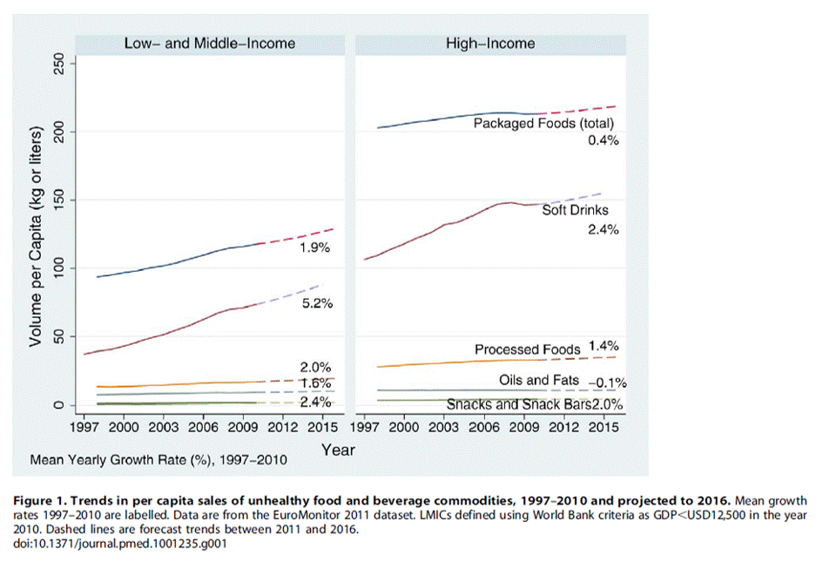
Stuckler, David, Martin McKee, Shah Ebrahim, and Sanjay Basu. "Manufacturing Epidemics: The Role of Global Producers in Increased Consumption of Unhealthy Commodities Including Processed Foods, Alcohol, and Tobacco." PLoS Med 9, no. 6 (2012): e1001235.
Notes:
Observation 1. Growth of snacks,
soft drinks and processed foods
is fastest in LMICs (i.e. GDP
#USD12,500). Little or no growth is
expected in HICs in the next 5 years.
Observation 2. The pace of increase
in consumption of unhealthy
commodities in several LMIC is
projected to occur at a faster rate
than historically in HICs.

Slide 58
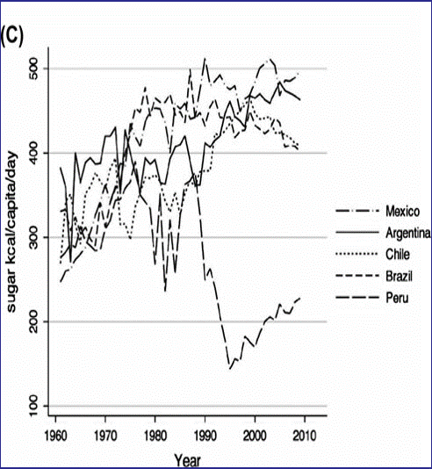
Intraregional supply changes: (C) variations in sugar supply in Latin America.
Basu, Sanjay. "The Transitional Dynamics of Caloric Ecosystems: Changes in the Food Supply around the World." Critical Public Health 25, no. 3 (2015/05/27 2014): 248-64.

Slide 59
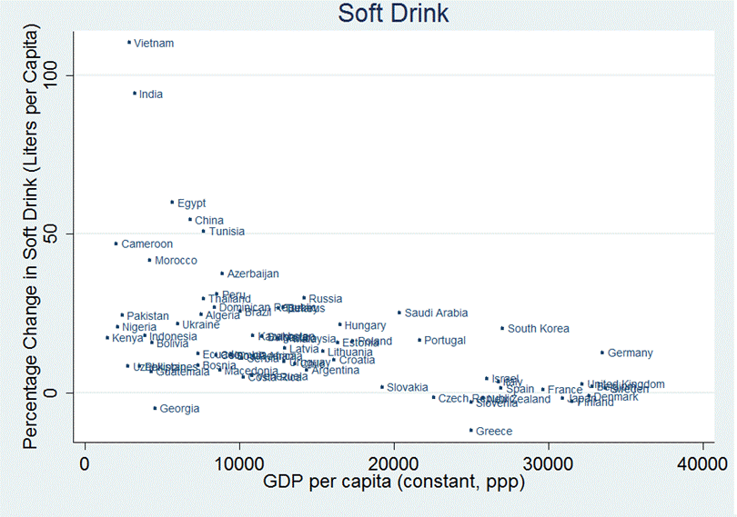
Relationship between Projected percentage increase in Soft Drink consumption and GDP, year 2010-2015, 76 countries
Stuckler, David, Martin McKee, Shah Ebrahim, and Sanjay Basu. "Manufacturing Epidemics: The Role of Global Producers in Increased Consumption of Unhealthy Commodities Including Processed Foods, Alcohol, and Tobacco." PLoS Med 9, no. 6 (2012): e1001235.

Slide 60
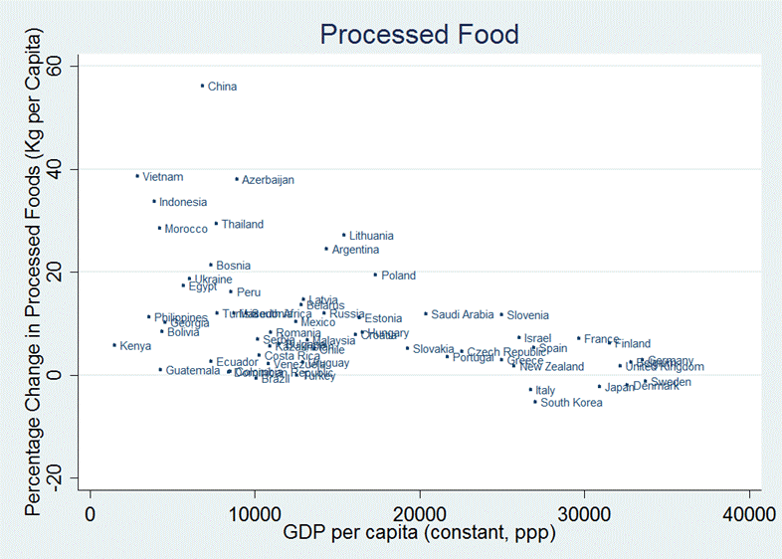
Relationship between Projected percentage increase in processed food consumption and GDP, year 2010-2015, 76 countries
Stuckler, David, Martin McKee, Shah Ebrahim, and Sanjay Basu. "Manufacturing Epidemics: The Role of Global Producers in Increased Consumption of Unhealthy Commodities Including Processed Foods, Alcohol, and Tobacco." PLoS Med 9, no. 6 (2012): e1001235.

Slide 61
Basu, Sanjay. "The Transitional Dynamics of Caloric Ecosystems: Changes in the Food Supply around the World." Critical Public Health 25, no. 3 (2015/05/27 2014): 248-64.
Notes:
From Stuckler, David, Martin McKee, Shah Ebrahim, and Sanjay Basu. "Manufacturing Epidemics: The Role of Global Producers in Increased Consumption of Unhealthy Commodities Including Processed Foods, Alcohol, and Tobacco." PLoS Med 9, no. 6 (2012): e1001235.
Observation 2. The pace of increase in consumption of unhealthy commodities in several LMIC is projected to occur at a faster rate than historically in HICs.
Which companies are the leading manufacturers and distributors of these commodities?
To shed light on this question we investigated the market shares of total packaged foods in Brazil, China, India, Mexico, Russia, and South Africa and, by way of comparison, the United States. As shown in Table 1, in LMICs, multinational corporations have already made a significant entry into food systems. In each country, one of the two market leaders is multinational, with the exception of China.
All countries also have Nestle in the top three manufacturers of packaged foods, with the exception of China. Overall, in Brazil Nestle had the highest market share of any multinational company, with 8.4%of the market. In Mexico, PepsiCo and Nestle have market shares of 5.3% and 3.8%, respectively. This level of market concentration is similar to that seen in HICs such as the US, where the leading companies were Kraft (6.8% of market share), PepsiCo (5.2%), and Nestle (4.2%).
Observation 3. Multinational companies have already entered food systems of middle-income countries to a similar degree observed in HICs.

Slide 62
http://www.freshplaza.com/article/91536/Three-TNCs-dominate-global-food-industry

Slide 64
http://www.freshplaza.com/article/91542/Global-retail-dominated-by-10-companies

Slide 65
Global food systems within the global economy
Globalisation and food systems
drive towards cash crops
unfair trade and dumping
meat, biofuels and land grabbing
corporate control (transnational oligopolies)
The political economy of global crisis - and impact on food systems
The neoliberal policy program to manage global crisis – and impact on food systems
Alternatives to neoliberalism

Slide 66
Food regimes
Settler colonial food regime (British domination, 1870-1914)
Mercantile industrial food regime (US domination, 1947-1995)
Corporate food regime (TNC domination, 1995+)
Industrial revolution and European colonialism
Decolonialism and US imperialism
Neoliberal globalisation
transnational corporations and the globalisation of class
Friedmann and McMichael, various

Slide 67
Walvin (2017) Sugar: the world corrupted from slavery to obesity. London: Robinson

Slide 68
Australia
Colonial settler regime (British empire)
invasion and displacement of Indigenous Australians
mass movements of convicts and free settlers
wheat, wool, meat exports to Europe (under imperial preference)
Mercantile industrial regime (US hegemony)
1973 Britain’s entry into the European Common Market (and the Common Agricultural Policy)
1973 Whitlam’s 25% cut in import duties
1983 Hawke Keating float the dollar and abolish capital controls
Corporate regime
1971 Macca’s opens in Sydney
2001 Aldi commences operations
2005 SPC sold to Coca Cola Amatil
2007 Global financial crisis
2010 TPP negotiations commence

Slide 69
Colonisation and the nutrition transition in East Africa
Seizure of arable land
Cash crop economies (taxation, colonial exports)
Broadacre monocultures for export
Destruction of indigenous markets
Land grabbing
Increasing reliance on food imports (wheat, rice, hydrogenated oils)
Increased reliance on highly processed food products
Rise of the supermarkets
Rural poverty and urbanisation
Mass market advertising
Raschke & Cheema (2008) Public Health Nutrition: 11(7), 662–674

Slide 70
Global economic governance and food systems
structural adjustment
trade relations
market discipline

Slide 71
Debt crisis and structural adjustment
1973 – first OPEC price rise
1970s – cheap money, aggressive bank lending, including to developing countries
1979 – stagflation
1981 – interest rates soar; developing country debt crisis
1980s – indebted countries forced to rely on IMF; structural adjustment a condition for bail out
cuts in public spending (including support to farmers)
reduce import barriers
re-orient agriculture to cash crops for export

Slide 72
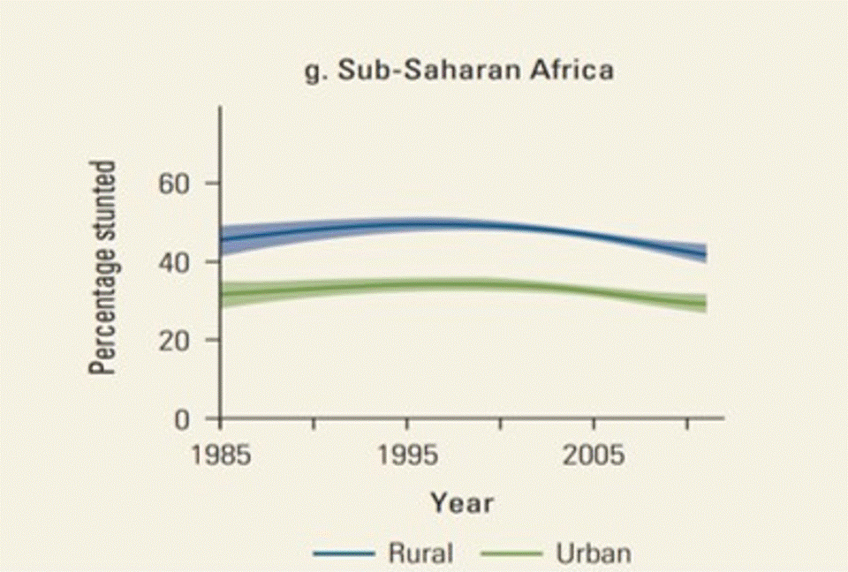
DCP3.2

Slide 73
Trade regulation
1944 - 1995 GATT
progressive re-negotiation of international agreements on tariffs
slow progress towards trade liberalisation (especially manufactured goods)
1995:
finalisation of the Uruguay Round of GATT negotiations
establishment of World Trade Organisation
Bilateral and regional trade and investment agreements

Slide 74
World Trade Organisation
Established 1995, based in Geneva
141 member countries
Structures
Director-General
Secretariat
Ministerial Conference
General Council
specific councils
Disputes Settlements Body (DSB)

Slide 75
Agreements
Multilateral Agreements on Trade in Goods (13)
General Agreement on Trade in Services (GATS)
Agreement on Trade-related Intellectual Property Rights (TRIPs)
Understanding on Rules and Procedures Governing the Settlement of Disputes (DSU)
Trade Policy Review Mechanism (TPRM)
(non mandatory) agreements (5)

Slide 76
Agreement on Agriculture
Not focused on health
But damaging to people’s health in agricultural exporting countries (including very poor countries) are:
agricultural barriers to rich country markets (Eu, Japan and US),
subsidies in those markets to support local producers (and exporters) and
dumping by rich countries in poor country markets including in producer countries

Slide 77
Farm subsidies
Europe: $US2.70 per cow per day
Japan: $US8.00 per cow per day
India: 600m farmers live on $US1.00 per day
USA: 25,000 cotton farmers receive $US10.1m per day
Europe: 80% of food subsidies go to agri-business
Tate and Lyle (sugar): $US404m in 2003/4
Arla Foods (Denmark): $US205m in 2003/04
Nestle (UK): $20m in 03/04

Slide 78
EU dumping in Africa
Dairy – eg impact on dairy production in Burkina Faso and Gambia
Poultry – dumping of chicken parts in West, Central and Southern Africa
Global research (2008). EU ‘plans to dump’ milk, butter in Africa. Global Research. http://www.globalresearch.ca/eu-plans-to-dump-milk-butter-in-africa/11079. See also OECD. http://www.oecd.org/tad/agricultural-policies/producerandconsumersupportestimatesdatabase.htm

Slide 79
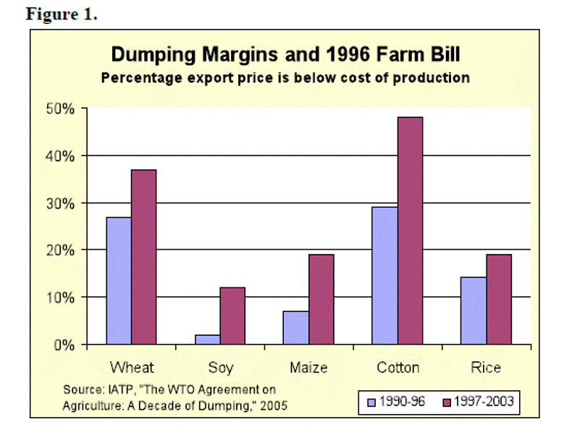
Wise, Timothy A. "Agricultural Dumping under NAFTA: Estimating the Costs of U.S. Agricultural Policies to Mexican Producers." Woodrow Wilson International Center for Scholars, 2010.

Slide 80
rich world agriculture protected, given domestic support and export subsidies
over supply (push to export agricultural produce)
loss of agricultural income
low prices and loss of markets for developing country farmers
Unfair trade: impact of rich world dumping and agricultural protection
rural poverty
cheap
food in cities
urban poverty (reserved army of unemployed)
rural urban migration
widening income inequalities
low wages
health effects of poverty (rural and urban) and displacement
growth in unskilled labour intensive export processing
weakening of social solidarity: public expenditure and public policy
rise of urban middle class business, skilled staff
Notes:
Farm subsidies
Europe: $US2.70 per cow per day
Japan: $US8.00 per cow per day
India: 600m farmers live on $US1.00 per day
USA: 25,000 cotton farmers receive $US10.1m per day
Europe: 80% of food subsidies go to agri-business
Tate and Lyle (sugar): $US404m in 2003/4
Arla Foods (Denmark): $US205m in 2003/04
Nestle (UK): $20m in 03/04

Slide 81
rich world agriculture protected, given domestic support and export subsidies
over supply (push to export agricultural produce)
loss of agricultural income
India: 600m farmers live on $US1.00 per day
low prices and loss of markets for developing country farmers
Unfair trade: impact of rich world dumping and agricultural protection
rural poverty
Europe: $2.70 per cow per day
cheap
food in cities
rural urban migration
80% of food subsidies in Europe go to agri-business
Tate and Lyle (sugar): $US404m in 2003/4
Arla Foods (Denmark): $US205m in 2003/04
Nestle (UK): $20m in 03/04
urban poverty (reserved army of unemployed)
Japan: $8 per cow per day
widening income inequalities
low wages
health effects of poverty (rural and urban) and displacement
growth in unskilled labour intensive export processing
weakening of social solidarity: public expenditure and public policy
rise of urban middle class business, skilled staff
Notes:
Farm subsidies
Europe: $US2.70 per cow per day
Japan: $US8.00 per cow per day
India: 600m farmers live on $US1.00 per day
USA: 25,000 cotton farmers receive $US10.1m per day
Europe: 80% of food subsidies go to agri-business
Tate and Lyle (sugar): $US404m in 2003/4
Arla Foods (Denmark): $US205m in 2003/04
Nestle (UK): $20m in 03/04

Slide 82
Food security and food sovereignty in India
Privatisation
Cut public
expenditure
Reduced state support
Rising input costs
Neoliberal policies
Pressure to grow cash crops
Small farmers
Hungry families
Import competition
Global pressures
Unfair trade
Falling prices
From Global Health Watch: www.ghwatch.org
Notes:
neglected agriculture
shifts in global prices to determine both cropping patterns and the viability of farming
generated greater possibilities of speculative activity in food items
Cultivators in developing countries have been ravaged by the fearsome combination of
exposure to import competition from highly subsidised agriculture in developed countries
removal of domestic protection of inputs
reduced access to institutional credit, to the point that even the global increase in agricultural prices after 2002 did not compensate sufficiently to alleviate the pervasive agrarian crisis
impact of financial speculation on world trade prices of food
Diversion of acreage and output to (subsidized) biofuel and stockfeed
Rising costs of inputs (including IP protected seeds and herbicides) reduced public expenditure
Neglect of ag
Impact of global warming on farming
More hungry people
Speculation and deregulation of commodity futures trading in the US from 2000
Total area devoted to feedcrop production 30% of total arable land and is driving deforestation in the Amazon
from 5 kg pa in India (2003 to 123 kg pp pa in the USA
Environmental damage
The means of, and the control over, the production of food are shifting from the farmers in the South to big agri-food businesses and transnational retail companies based mainly in the North, removing power from local producers, consumers and, in many instances, policy-makers. Liberalized trade regimes, food price speculation in the global market and land grabs are contributing to this shift. The Agreements of the World Trade Organization (WTO) have moved control over the right to food and food security to the global market (Friel et al. 2013; Ghosh 2010). Human-induced climate change plus other forms of environmental degradation are also affecting the food system, contributing to the impaired quantity, quality and affordability of food in many countries (UNDP 2007).
India
Poverty (rural and informal urban settlements)
Decline in public expenditure on rural development (impact on rural incomes and employment)
Macro economic policy prescriptions: Decline in government expenditure generally
Trade policy: reduced tariffs and ‘anti-dumping duties’
Encouraging move to export oriented agriculture (cash crops) impacts on food sovereignty and jobs; with move to
But prices fall and small farmers are caught; everybody is being told the same
Cost of inputs (fertilizer, seeds. water); electricity privatisation of electricity; removal of cross subsidies
Food support schemes
PICTs

Slide 83
India
(GHW)

Slide 84
Mexico 10 years post NAFTA
1% growth rate
2m farmers left their land
1m jobs in lost in corn production
Unemployment in cities
6m undocumented migrants to US
Increased exports of fruit and veges
Increased imports of subsidised corn from US lead to falling prices and loss of livelihood
Dumped grains > wheat cultivation halved
Importing 99% soybeans, 80% rice, 30% beef, pork and chickens, 30% of beans
importing 42% of food in 2003 cf 13% in 1993

Slide 85
TRIPS, seeds and herbicides
Monsanto and glyphosate
Hybrid seeds and traditional seed production
Patenting of long cultivated seeds

Slide 86
Financialisation and food price speculation
2008 Global financial crisis
2009 Global food price crisis

Slide 87
Ghosh, Heintz and Pollin (2012) IJHS, Volume 42, Number 3, Pages 465–483.
GHW3 (2011) Global food crisis

Slide 88
The Global Economy
100 Years
Colonialism and imperialism
WW1
WW2
Independence (and imperialism)
Long boom (1948-1970
Stagflation (1979-81 )
The lost decade (1980s)
The great moderation
Trump: revolt of the plebs
Dot Com bubble
GFC
Asian crisis

Slide 89
The long boom (1945-1975)
The post-WW2 environment
need for reconstruction (huge demand)
increasing productivity (motor vehicles and cheap oil)
industrial capacity released by post-war demobilisation
The boom
capital, labour and technology brought together to make things and services that people need and are able to pay for
increasing productivity (associated with new technology) frees up labour to make new things and to recycle wages as consumption (hence more profit, investment and sales)
some ‘trickle down’ to the poor (associated with Keynesian policies) and to the Third World (benefiting from trade opportunities associated with rapid growth)
Notes:
The 30 years from 1945 to 1975 were characterised by high annual growth rates and relatively short recessions.
Two major factors contributed to this. First, on the demand side, was the huge need for reconstruction after the war and the pent up consumer demand (and savings) after so much hardship and privation; second, on the supply side, the huge industrial capacity which had been built up during the war, much of which was able to convert to producing for the civilian market.
In addition to these post-war factors the development of the internal combustion engine associated with cheap oil contributed greatly to increasing productivity in many different sectors of production. This phenomenon of a major technology contributing to a prolonged boom was an echo of previous eras when the development of railways and steel had likewise led to high levels of productivity and growth.
This period illustrates the key ingredients of economic growth coming together: capital, labour, technology and markets. Capital and labour are brought together to make goods and services that people (households, governments and corporations) need and are able to pay for. Increasing productivity (associated with new technologies) frees up labour to make new goods and services. Wages (and taxes) are recycled as consumption and increasing business activity also contributes to increased demand.
While the dynamics of the long boom were primarily rooted in the industrialised world there was some trickle down to the developing countries. Increasing production in the rich world raised the demand for many of the commodities which were sourced from developing countries and under import substitution regimes many newly independent Third World countries commenced the process of industrialisation and capital accumulation. A small number of these countries were able to complete this process (most notably the ‘Asian tigers’).
Next

Slide 90
1975-85 - Stagflation and the failure of Keynesianism
Recession (cyclical slowdown on top of structural over-production)
growing imbalance between productive capacity and market demand;
emergence of ‘jobless growth’; weakening role of employment and wages in maintaining consumption
Emerging inflation
Keynesian counter-cyclical policies deployed to contain the slow down; ineffective (because slow down structural, not cyclical) but contribute to inflation because increase money supply without boosting employment and economic activity at the cost of budget deficits and inflation
increasing price pressures as different players seek to defend against price increases fought out through various forms of monopoly power (oil with OPEC, labour with strong unions, brand names and protected technologies)
goods and services for the Vietnam war flood the world with dollars (increase of global money supply) lead to inflation and depreciation of the dollar (leads to rejection of gold standard in 1972)
Notes:
The late 1970s was characterised by stagflation, a combination of prolonged recession associated with creeping inflation.
The economic slowdown commencing in the late 1970s reflected a combination of a cyclical slowdown (cyclical over-production) in the normal business cycle and the emergence of structural over-production (discussed further below). The stresses on the US and global economy associated with the US Vietnam War also contributed.
Associated with the recession was the emergence of recalcitrant inflation which reflected several factors including
the printing of money by the US to pay for the Vietnam war associated with its capacity to globalise the consequent inflation because of the status of the dollar as the world reserve currency;
the resistance of the inflation to Keynesian policies (because it was a structural slow down rather than just the ‘normal business cycle’;
the presence of strong monopoly power in certain sectors of the economy.
Goods and services for the Vietnam war sourced from outside the USA and paid for in dollars (because of the international status of the dollar) caused a global flood of dollars (increase of global money supply) contributing to global inflation and depreciation of the dollar (leads to rejection of glold standard in 1972)
The inflation of this period was made worse by the continuing application of Keynesian stimulatory policies in a situation where the slow down was structural (reduced demand because of technology replacing labour and low wage labour replacing high wage labour) rather than cyclical (excessive capitalisation and employment). Expansionary Keynesian policies increase money supply (through lower taxes and greater government spending – funded by borrowng). Increased money supply in these circumstances did not boost employment or local business but led to increased budget deficits and inflation.
The increasing price pressures (associated with monopoly power and therefore not disciplined by the ‘free market’) were particularly strong in oil (OPEC), labour (strong unions), and business (where monopolies are associated with brand pre-eminence and protected technologies). All of these stakeholders claimed that they were just pushing up their prices to overcome the effects of other inflationary pressures. Another interpretation of the period has been that labour and capital were fighting to achieve greater shares of the falling rates of economic growth.
Next

Slide 91
1981: Reagan, Thatcher and monetarism
Monetarism
defeats Keynesianism
public debt and counter-cyclical public spending not working
argues for sole reliance on interest rates to control the business cycle
Reagan and Thatcher
organised labour to blame for inflation and recession; break the unions
‘fight inflation first’: steep increases in interest rates deepen recession
slows the economy, decreases demand, controls price increases
increased unemployment, weakens the unions and controls wages growth (accompanied by aggressive industrial relations strategies)
Notes:
There was strong business antipathy to inflation (because of increased uncertainty in business planning). This pressure lead to ‘fight inflation first’ slogans with increased interest rates (to reduce the money in circulation) and tight limits on government spending (to rein in government deficits). These policies were most famously associated with Thatcher and Reagan but were applied during the succeeding decade by many governments.
The apparent failures of national Keynesianism during this period (in particular inflation and high levels of government debt) contributed to the ascendancy of monetarism, which emphasised the use of official interest rates to curb or encourage the business cycle and argued for a balanced budget and for a minimalist role for government in the economy.
This led to a situation in the early 1980s where the need to stoke the economy would have suggested low interest rates but the need to control inflation suggested the need for high interest rates. Because of the business sector pressure to ‘fight inflation first’ the policy makers elected to implement high interest rate policies which ensured that the recession was deeper and longer than it might otherwise have been.
Next

Slide 92
The Debt Trap
The trap set
1973: OPEC price rise; oil producers flush with cash; deposited in banks
Banks send salesmen around the world lending money at low and negative interest rates (negative after taking inflation into account)
lending to corporations (but with government guarantee) in South America
lending direct to governments in Africa
The trap sprung
1980: interest rates escalate (peaking at 17% in the US in 1981) at a time of recession, imposing repayment and servicing burdens that many poor countries could not carry
the 1980s as ‘the lost decade’
1984 global resource flows reverse
Notes:
We need to step back a bit here to note how the rising interest rates of the early 1980s precipitated the Third World debt crisis which will figure in later parts of this story.
Following the OPEC oil price rise of 1973 the oil producers were flush with cash, more cash than they could spend or invest and so much of it was deposited with the commercial banks.
The banks sent salesmen around the world lending money at low and negative interest rates. Interest rates are effectively negative when they are lower than the prevailing rate of inflation.
Much of this lending was to private corporations particularly in South America but generally with government guarantees which meant when the debt crisis was sprung the governments were held accountable for repaying and servicing these debts. In Africa most of the lending was direct to governments.
In the early 1980s with the rise of monetarism interest rates escalated (to a peak of 17% in the US in 1981) imposing repayment and servicing burdens that many poor countries could not carry.
The debt trap was sprung. We shall return to the debt trap later in this story and the role of the IMF and WB in policing the re-payment of this debt.
Next

Slide 93
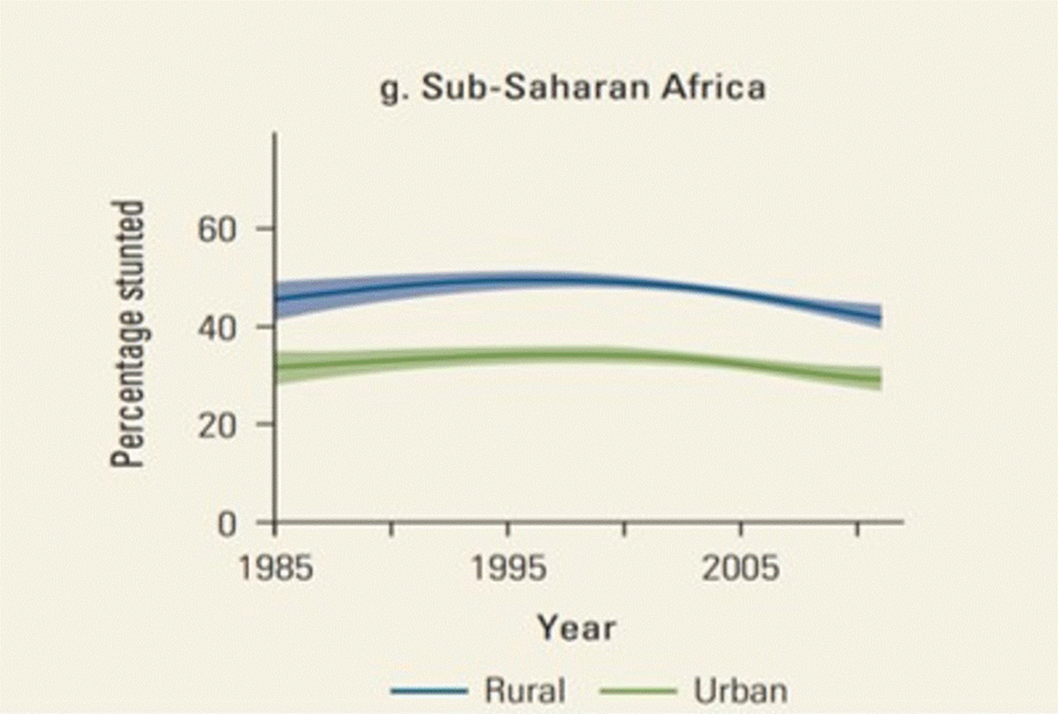
The Debt Trap
The trap set
1973: OPEC price rise; oil producers flush with cash; deposited in banks
Banks send salesmen around the world lending money at low and negative interest rates (negative after taking inflation into account)
lending to corporations (but with government guarantee) in South America
lending direct to governments in Africa
The trap sprung
1980: interest rates escalate (peaking at 17% in the US in 1981) at a time of recession, imposing repayment and servicing burdens that many poor countries could not carry
the 1980s as ‘the lost decade’
1984 global resource flows reverse
Notes:
We need to step back a bit here to note how the rising interest rates of the early 1980s precipitated the Third World debt crisis which will figure in later parts of this story.
Following the OPEC oil price rise of 1973 the oil producers were flush with cash, more cash than they could spend or invest and so much of it was deposited with the commercial banks.
The banks sent salesmen around the world lending money at low and negative interest rates. Interest rates are effectively negative when they are lower than the prevailing rate of inflation.
Much of this lending was to private corporations particularly in South America but generally with government guarantees which meant when the debt crisis was sprung the governments were held accountable for repaying and servicing these debts. In Africa most of the lending was direct to governments.
In the early 1980s with the rise of monetarism interest rates escalated (to a peak of 17% in the US in 1981) imposing repayment and servicing burdens that many poor countries could not carry.
The debt trap was sprung. We shall return to the debt trap later in this story and the role of the IMF and WB in policing the re-payment of this debt.
Next

Slide 94
The ‘Sub-prime Mortgage Crisis’
Asset bubbles burst; ‘wealth’ becomes ‘debt’
Extensive use of doubtful collateral (securitised debt) to support borrowing revealed
Credit squeeze: banks globally withhold credit because of their exposure to doubtful loans (deleveraging)
Consumption contracts (credit dries up; saving preferred because of threat of recession)
Production and employment contract because credit dries up and consumption slows
Global recession looms because of significance of US market to exporters globally
Risk of foreign holders of US bonds selling off or stopping buying bonds (buy oil futures instead or spend on crisis)
Risk of USD falling
Notes:
The present global recession began with a financial crisis which began with the ‘sub-prime mortgage crisis’.
In economic parlance an asset bubble is a period during which the prices paid for that particular asset class increase well beyond any estimation of underlying of fundamental values. In the previous decade housing prices in the US, Australia and parts of Europe had been progressively increasing well beyond reasonable values. It was a housing bubble. During the rising phase the inflated house prices gave home owners increased borrowing capacity, to pay for cars, property, vacations or shares. When the bubble burst and prices started to fall the value of the family home as collateral for such loans fell also and the banks started asking for further collateral or repayment of the loan. At the same time people who had gone into debt to buy their home found that the value of their house as collateral against their home loan was falling and the bank was asking for more collateral or repayment of the loan.
The impact on the housing market was bad enough but the poison had spread far and wide across the financial system through the system of securitised debt. Where as once the mortgage originator, the orginal lender, might have held the debt and benefitted from the income stream, now the morgages were being packaged up for sale to other financial institutions. In on-selling the mortgage the bank sells the income stream and the right to the original capital in return for cash in hand which can then be used to originate further mortgages. Some of those purchasing these packaged mortages may have been looking for the income stream; others were looking for assets that could be used as collateral in a further round of borrowing. At this point the borrowers are in the corporate sector borrowing for large building projects or infrastructure projects or mergers or acquisitions.
This sequence of on borrowing was uncertain enough but in fact the quality of the original assets were in many instances quite uncertain. As the mortgage originators were able to get rid of their loans so easily and restore their capital the standards being expected of borrowers, house buyers, were becoming less and less stringent. In fact many of the mortages being packaged, being packaged in very complex ways, were ‘sub-prime’, meaning high risk, meaning that many of the borrowers had no chance of paying them back.
So as house prices started to fall, once the bubble had burst, the first casualties were the sub-prime borrowers who defaulted when asked to increase their collateral or repay part of their loan. The next were the home owners who had borrowed for other purposes against the value of their homes. Finally the commercial sector felt the sting, particularly the property developers, who had borrowed from the banks against the face value of packaged mortgages. Once the banks started to look at the value of those mortgages they started asking for more collateral, higher interest or repayment. And so the cards started to fall, first the sub-prime borrowers defaulted; then the banks found themselves holding assets worth far less than their face value and so they started to put pressure on the next two groups, those who had borrowed against the value of their own homes and the businesses who had borrowed against the value of their holdings of securitised debt.
The defaults in the housing sector gradually transform into a system wide credit squeeze (as the banks try to rebuild their capital base), punctuated by occasional high profile failures which go down owing billions. The public sector will bail out those who are too big to be allowed to collapse. In this game of pass the parcel, all of the intermediaries who repackaged and on-sold the mortgages have got their payment. It is just the original borrower and the final borrower who will go down but if the taxpayer is willing to bail out the final borrower then it will be just (!) the original home buyer who loses; they lose their home.
So from the housing market to the financial system as a whole to the ‘real economy’ the dominoes fall. Consumption contracts as credit dries up and as households prefer to saving rather than spending because of the threat of recession.
Production and employment contract because credit dries up and consumption slows down.
Because of the significance of the US market to the whole global economy the recession in the US is quickly transferred to the countries which export to the US and to the rest of the world.
The next domino, still hovering is the collapse of the US dollar which could become a rout if the foreign bond holders are frightened enough into selling off their US bonds. If the value of the US dollar were to fall foreign imports become more expensive and the US purchases from the rest of the world slow down. At this stage the Chinese andn Middle Eastern oil producers are staying with the US dollar; the risk that they face is that if they start to sell down their holdings of USD they precipitate the collapse they are afraid of.
Next

Slide 95
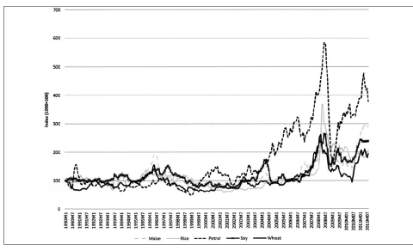
The ‘Sub-prime Mortgage Crisis’
Asset bubbles burst; ‘wealth’ becomes ‘debt’
Extensive use of doubtful collateral (securitised debt) to support borrowing revealed
Credit squeeze: banks globally withhold credit because of their exposure to doubtful loans (deleveraging)
Consumption contracts (credit dries up; saving preferred because of threat of recession)
Production and employment contract because credit dries up and consumption slows
Global recession looms because of significance of US market to exporters globally
Risk of foreign holders of US bonds selling off or stopping buying bonds (buy oil futures instead or spend on crisis)
Risk of USD falling
Notes:
The present global recession began with a financial crisis which began with the ‘sub-prime mortgage crisis’.
In economic parlance an asset bubble is a period during which the prices paid for that particular asset class increase well beyond any estimation of underlying of fundamental values. In the previous decade housing prices in the US, Australia and parts of Europe had been progressively increasing well beyond reasonable values. It was a housing bubble. During the rising phase the inflated house prices gave home owners increased borrowing capacity, to pay for cars, property, vacations or shares. When the bubble burst and prices started to fall the value of the family home as collateral for such loans fell also and the banks started asking for further collateral or repayment of the loan. At the same time people who had gone into debt to buy their home found that the value of their house as collateral against their home loan was falling and the bank was asking for more collateral or repayment of the loan.
The impact on the housing market was bad enough but the poison had spread far and wide across the financial system through the system of securitised debt. Where as once the mortgage originator, the orginal lender, might have held the debt and benefitted from the income stream, now the morgages were being packaged up for sale to other financial institutions. In on-selling the mortgage the bank sells the income stream and the right to the original capital in return for cash in hand which can then be used to originate further mortgages. Some of those purchasing these packaged mortages may have been looking for the income stream; others were looking for assets that could be used as collateral in a further round of borrowing. At this point the borrowers are in the corporate sector borrowing for large building projects or infrastructure projects or mergers or acquisitions.
This sequence of on borrowing was uncertain enough but in fact the quality of the original assets were in many instances quite uncertain. As the mortgage originators were able to get rid of their loans so easily and restore their capital the standards being expected of borrowers, house buyers, were becoming less and less stringent. In fact many of the mortages being packaged, being packaged in very complex ways, were ‘sub-prime’, meaning high risk, meaning that many of the borrowers had no chance of paying them back.
So as house prices started to fall, once the bubble had burst, the first casualties were the sub-prime borrowers who defaulted when asked to increase their collateral or repay part of their loan. The next were the home owners who had borrowed for other purposes against the value of their homes. Finally the commercial sector felt the sting, particularly the property developers, who had borrowed from the banks against the face value of packaged mortgages. Once the banks started to look at the value of those mortgages they started asking for more collateral, higher interest or repayment. And so the cards started to fall, first the sub-prime borrowers defaulted; then the banks found themselves holding assets worth far less than their face value and so they started to put pressure on the next two groups, those who had borrowed against the value of their own homes and the businesses who had borrowed against the value of their holdings of securitised debt.
The defaults in the housing sector gradually transform into a system wide credit squeeze (as the banks try to rebuild their capital base), punctuated by occasional high profile failures which go down owing billions. The public sector will bail out those who are too big to be allowed to collapse. In this game of pass the parcel, all of the intermediaries who repackaged and on-sold the mortgages have got their payment. It is just the original borrower and the final borrower who will go down but if the taxpayer is willing to bail out the final borrower then it will be just (!) the original home buyer who loses; they lose their home.
So from the housing market to the financial system as a whole to the ‘real economy’ the dominoes fall. Consumption contracts as credit dries up and as households prefer to saving rather than spending because of the threat of recession.
Production and employment contract because credit dries up and consumption slows down.
Because of the significance of the US market to the whole global economy the recession in the US is quickly transferred to the countries which export to the US and to the rest of the world.
The next domino, still hovering is the collapse of the US dollar which could become a rout if the foreign bond holders are frightened enough into selling off their US bonds. If the value of the US dollar were to fall foreign imports become more expensive and the US purchases from the rest of the world slow down. At this stage the Chinese andn Middle Eastern oil producers are staying with the US dollar; the risk that they face is that if they start to sell down their holdings of USD they precipitate the collapse they are afraid of.
Next

Slide 96
The threat of ‘over-production’ (in the old economies)
Where expanding (capital intensive) productive capacity (with stagnating employment growth) exceeds effective demand owing to
saturated (‘mature’) markets and/or
markets with real needs but limited purchasing capacity
‘Compensatory’ mechanisms which exacerbate the damage from ‘over-production’
understood in the corporate world in terms of reduced profitability
understood in the policy world as falling growth rates
eliciting a range of corporate strategies and policy responses
many of which exacerbate the risk of crisis
Notes:
The linked concepts of Fordism and post-Fordism provide a useful entry to the concept of structural as opposed to cyclical over-production.
Fordism (a direct reference to Henry Ford) describes an economic regime of mass production, mass employment and mass consumption. The Ford metaphor is a reference to Ford employees being paid enough in wages to actually buy a Ford motor car. The significance of the metaphor as a description of a broader economic configuration is the concept of workers as consumers and the significance of mass employment and high wages sustaining mass markets.
By contrast, the concept of post-Fordism refers to a situation where expanding productivity associated with stagnating employment growth threatens an overhang of productive capacity over effective demand because of stagnant purchasing capacity.
The period since 1975 (according to the post-Fordist interpretation) has been characterised by increasing (capital intensive) productive capacity but stagnant purchasing capacity, due to a combination of saturated markets and limited purchasing capacity where otherwise there would be continuing demand (because of the widening mismatch between productive capacity and employment).
The tendency of productive capacity to outpace effective demand threatens economic crisis. In theory this threat should be manageable but the threat of crisis is made more urgent by the fact that the ‘compensatory’ mechanisms adopted at the corporate and policy levels tend to exacerbate the threat of ‘over-production’ and bring on the crisis.
Before looking at different strategies for managing the threat of over-production we need to look at some of the compensatory mechanisms adopted at the corporate and policy levels and how they exacerbate the crisis.
The threat of structural over-production is understood in the corporate world in terms of market saturation and reduced profitability which eliciting a range of compensatory strategies such as mergers and acquisitions, reduced employment and wage cuts all of which contribute to further reduce demand.
The threat of structural over-production is understood in the policy world in terms of falling growth rates eliciting a range of system responses and policy responses many of which also further exacerbate the risk of crisis.
Next

Slide 97
‘Over-accumulation’
Reduced flow of profit into productive investment because of sluggish demand
Increased flow of profit into
mergers and acquisitions (reduce capacity, increase market share)
asset speculation (housing, shares, currency, futures, etc)
debt funded consumption
Expansion of finance sector
employment
profit
political influence

Slide 98
Declining growth: compensatory system responses
Diversion of investment into the financial sector (profit from trade and production flows into financial institutions)
Private consumption supported through increasing private debt (recycling profit as consumption)
Corporate rationalisation (including M&As, closures and bankruptcies) financed through corporate debt
Increase size and power of financial sector
Notes:
At the system level the looming overhang will be associated with a number of system responses including those listed on this slide.
As the return on investment in production falls there is an increasing flow of funds to the financial sector (profit from trade and production flowing into financial sector investment).
With increasing funds in the financial sector increasing private consumption expenditure is supported through increasing private debt (recycling profit as consumption).
Corporate rationalisation (including M&As, closures and bankruptcies) financed through corporate debt.
Increase size and power of financial sector
Next

Slide 99
Reduced profitability: compensatory corporate strategies
Turn East to participate in China’s growth (which depends in part on US and EU markets)
New markets, new products and better marketing
Commodifying the social – the marketisation of what were family, community and public sector functions
Externalise costs (including to labour and to the environment)
Increase market power (and capacity to increase prices)
Consolidate production and increase market share through mergers and acquisitions*
Reduce wages (union busting, relocation)*
Replace well paid labour with technology*
*These strategies will further reduce demand (reduce the role of employment in recycling wages into consumption)
Notes:
From the corporate perspective the threat of an overhang of production over demand is perceived as a threat of reduced profitability.
The most obvious response will be to search for new markets, new products and better marketing. This may not always be positive such as where it involves the commodification of family and community functions, currently sustained outside the marketplace.
Another strategy will be to externalise costs (including to labour and to the environment).
Other strategies include:
increasing market share (horizontal M&As),
increasing market power (eg vertical integration)
reducing wages,
replacing well paid labour with technology,
These strategies contribute to further reducing demand:
mergers and aquisitions have the effect of disinvesting in productive capacity and reducing employment
increasing market power means that those businesses can charge higher prices and maintain profit but higher prices do not lead to increased markets
reducing wages and replacing labour with technology further dampens demand
Next

Slide 100
Unintended adverse consequences
Replacing high wage labour with low wages and technology exacerbates the over-hang of productive capacity over effective demand
Increasing economic integration globally creates new barriers to ‘developing countries’ achieving ‘development’
Increasing economic integration expands the market for the established TNC producers but further exacerbates the overhang of productive capacity over effective demand
Deregulation and externalising costs to the environment further destabilises global environment
Notes:
Some of these corporate and policy responses might tend to restore the conditions for sustainable growth. However, many of these corporate and policy responses are likely to further reduce effective demand by reducing wages, employment and public expenditure.
Many of the policy responses also have adverse consequences in relation to the environment (for example, refusal to reduce greenhouse gas production), in relation to family and community life (the commodification of family and community functions) and the decay of social infrastructure.
The policy package also tends to increase inequalities within countries and to further impoverish developing countries.
Next

Slide 101
So what prevents the crisis from engulfing the economy globally?
The situation is already critical for millions of poorer people (in rich and poor countries)
trading regime which enforces the flow of value from poor to rich countries
policy regime enforces the divide between those who participate in the new global economy and those who are excluded
for these latter groups the crisis has already arrived
However, continued growth globally (albeit slower) has been supported through
growth in China and India (and other ‘emerging economies’)
commodification of family, community, government functions (including health care)
unsustainable exploitation of environmental ‘services’
role of debt in sustaining demand (recycling capital as consumption)
global support for US consumption (supporting an over-valued dollar)
intensified transfer of value from periphery to centre (from South to North)
Notes:
The conditions which supported the long boom are weakening through a combination of increasing levels of productivity (particularly productivity enhancements associated with job-replacing technologies) and through market saturation and/or weak purchasing power (particularly in many countries).
So what prevents the crisis from declaring itself and engulfing the economy globally?
In fact the crisis is already devastating the economies and communities of many Third World countries, partly because of the direct effects of the economic slowdown and more brutally because of the impact of the kinds of economic policies being imposed globally by the rich countries in their attempts to defer or reduce the impact of the crisis on their economies.
There are a number of dynamics through which value is transferred from poor to rich countries, in particular: enforced (and repeated) repayment of debt; declining terms of trade and unfair trade. The participation of developing countries in this regime is achieved through a combination of IMF bullying, projection of US military power and the collaboration of local elites.
However, in the rich world continued growth (albeit slow) is also supported through the growing role of debt in sustaining demand.
Two important dynamics which warrant further explication. These are firstly, the recycling of capital and savings as consumption through debt at a national level and secondly, at an international level, the special status of the US dollar which enables the US to maintain the value of the dollar (despite a large trade deficit) and continue to buy goods from the rest of the world.
We will look at each of these dynamics briefly.
Next

Slide 102
Continuing transfer of value from periphery to centre (S ➔ N)
Debt repayment
role of IMF (and SAP / PRSP) as the enforcer
Maintaining high dollar reserves (at low interest) as ‘insurance’ against currency crisis means cost of capital (for real investment) is higher
Brain drain
Tax evasion
Theft
Unfair trade
‘free trade’ in manufactured goods
protectionism for IP and agriculture
barriers to free trade in people
Declining terms of trade
commodities vs manufactures
Notes:
Prior to the mid 1980s the net flow of resources between the OECD countries and the ‘global South’ was in the North to South direction. This reversed during the mid 1980s and has remained negative since then.
The mechanisms which mediate this S -> N flow of value are shown on this slide.
[explain]

Slide 103
Neoliberalism: a political belief system
Government can’t be trusted
markets know better than planners
bureaucracies dominated by self-interest
Markets best mechanism for allocating resources
role of the state is to protect and extend markets and private property
no role for industry policy (eg price supports)
Privileging private property
small government, low tax, low public expenditure
intellectual property rights, investor protection
Global economic integration
IP protection
investor protection
market access,
covert protection of Northern agriculture
Economic policy principles and tools
deregulate, commodify and privatise
low taxation, low public debt, balanced budgets
free trade, no capital controls, market exchange rates, global economic integration
interest rates the preferred tool in economic policy (over fiscal policy)
labour market flexibility / deregulation
discounting social protection (and equity)
discounting environmental stewardship
Notes:
a policy package for managing the threat of post-Fordist crisis
Objective universal and necessary policy paradigm (‘there is no alternative’ - TINA),
or
Partisan policy package, managing the threat of post-Fordist crisis in accordance with the perspectives and interests of the
transnational corporations
transnational capitalist class
political hirelings of the above

Slide 104
Implications for health of the neoliberal economic policy agenda
Stratified health care; minimal public funding; private health insurance; private provision
access barriers
health care impoverishment
maternal deaths
Social determinants of health
agriculture
farmers driven off their land by dumped agricultural imports;
small scale subsistence farming replaced by agribusiness production for export
food crisis (meat, petrol, speculation)
employment: no or low safety nets; jobs and wages determined by markets; poverty
infrastructure: lack of clean water and sanitation, open defaecation
violence and conflict
mass migrations
financial instability and recurring crises

Slide 105
Alternatives to neoliberalism
Restore sovereignty to the Nation State (regulate the transnational corporations and banks)
Move towards greater democracy in global governance (away from big power hegemony)
Protect local production, local supply, local services (the Chinese path); regionalism
Forge new alliances between progressive forces in the North and in the global South
Domestic security (economic and cultural) as a condition for generosity (eg to refugees)
Living well (buen vivir) as alternative to materialism
Communication and personal contact as conditions for solidarity
Notes:
There are alternatives to neoliberalism as in the seven principles listed on this slide.

