Slide 1
Macroeconomics and Health
IPHU, Cape Town June, 2012

Slide 2
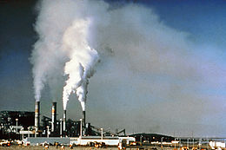
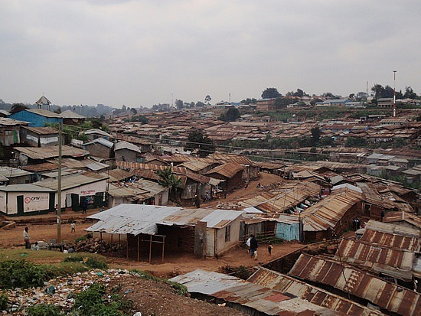
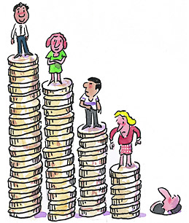
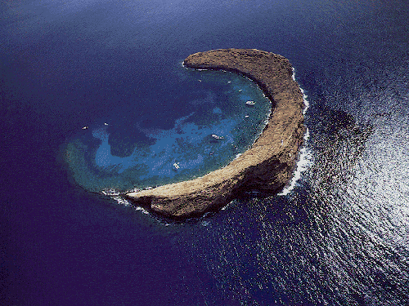

Slide 3
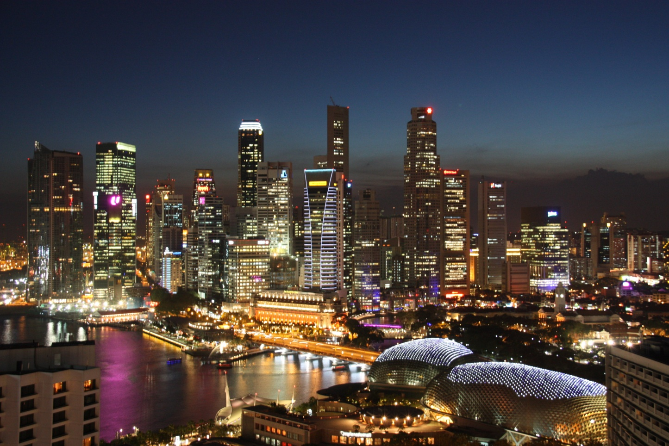
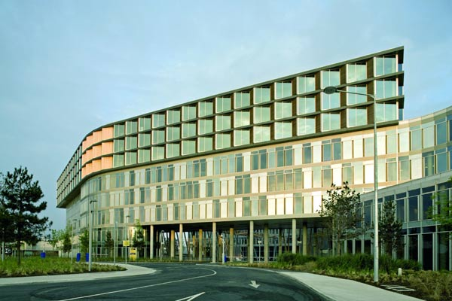

Slide 4
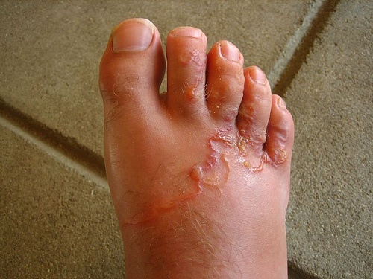
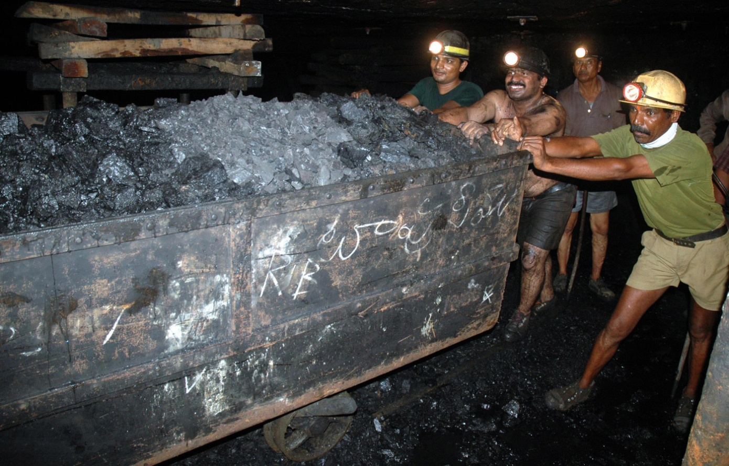
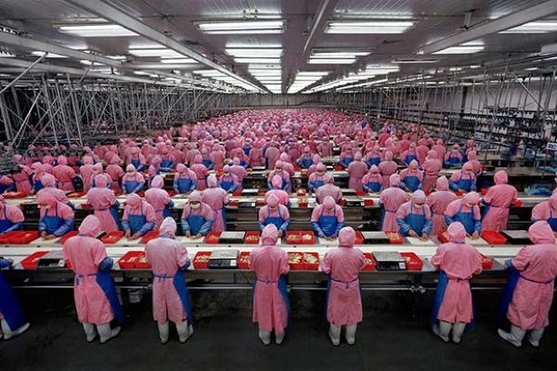

Slide 5
Two way relationship
Macroeconomic environment
shapes population health and
health care policy
Health as input into macroeconomic policy thinking
health system as a sector of the economy
population health as economic resource

Slide 6
Macroeconomic environment shapes health care policy
Economy-wide resources to pay for health care (public or private)
Public sector revenue
tax capacity
policy assumptions regarding taxation (eg ‘tax competition’)
Macroeconomic policy framing health policy
private sector friendly policies
need for public subsidy to reduce the burden on employers in a social insurance model

Slide 7
Macroeconomic environment shapes population health and how we address the social and environmental determinants of health
Macroeconomic policy framing the social and environmental determinants of health
occupational health
safe and healthy environments
investment in housing and infrastructure
social protection
income inequality and social participation
Macroeconomic policy frames the capacity to address the social and environmental determinants of health
regulation: decent laws which are policed
competitive deregulation: the race to the bottom
trade laws which limit government capacity to regulate

Slide 8
Health system as a consideration in macroeconomic policy thinking
Health costs at family level and household savings
health (social) security as a way of loosening savings
family responsibility (eg ISAs) as a way of encouraging savings
Private health care (and related industries) as investment opportunity
private (or subcontracted) health insurance
pharmaceutical industry
Health care expenditure as the purchase of goods and services from other sectors
employment
financial services (private or contracted insurance)
pharmaceutical industry
local buildings and supply industries
Health care (and related industries) as export prospects

Slide 9
Population health as a consideration in macroeconomic policy thinking
Labour as a resource to be consumed
slavery
poorly regulated mining
low paid mass assembly facilities
Labour power as a resource to be nurtured
disease as a cause of low productivity
disease as a cause of labour shortage

